Slide 1
Adjusting for confounders
Tyler Tuan

Slide 2
Without the needs for intervention, we can infer causality by adjusting for confounders.

Slide 3
Propensity-based methods
Assignment Mechanism
Randomized (intervention)
Propensity (observation)
Propensity grouping
IP-weighting
G-formula

Slide 4
Assignment Mechanism
Intervention
Randomized trials
Independent from confounders
Observation
Propensity
Depend on confounders

Slide 5
Data of choice: 1) Set of treatments A 2) Set of responses Y 3) Find all possible causal relationships

Slide 6

$$E[Y^{A=a}]$$

Slide 7
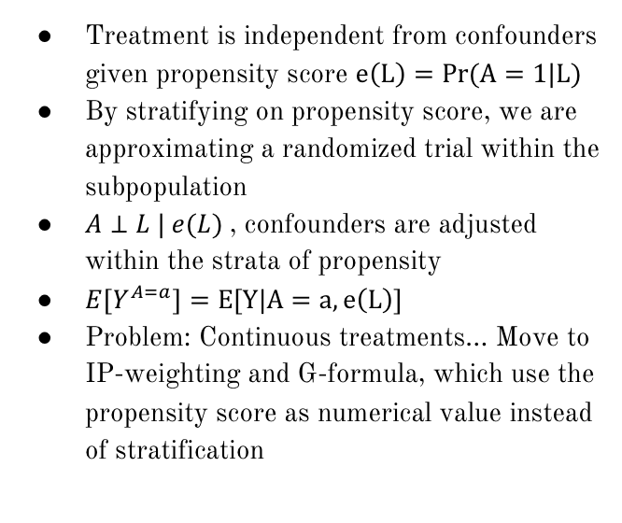
Propensity grouping
Treatment is independent from confounders given propensity score $e\left(L\right)=Pr(A=1|L)$
By stratifying on propensity score, we are approximating a randomized trial within the subpopulation
$A⊥L | e(L)$, confounders are adjusted within the strata of propensity
$E[Y^{A=a}]=E[Y|A=a,e\left(L\right)]$
Problem: Continuous treatments… Move to IP-weighting and G-formula, which use the propensity score as numerical value instead of stratification

Slide 8
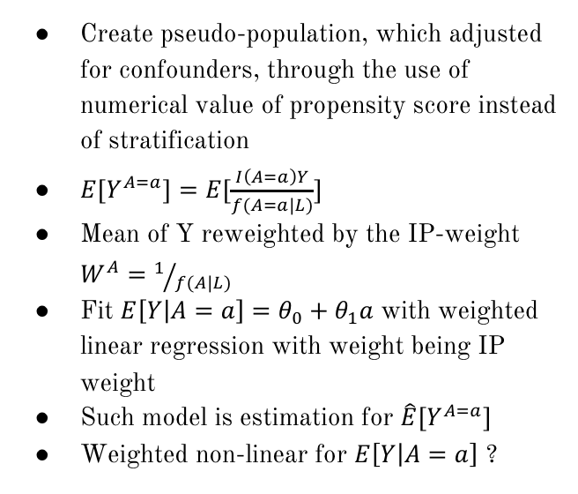
IP-weighting
Create pseudo-population, which adjusted for confounders, through the use of numerical value of propensity score instead of stratification
$E[Y^{A=a}]=E[\frac{I\left(A=a\right)Y}{f(A=a|L)}]$
Mean of Y reweighted by the IP-weight $W^{A}=1/{f(A|L)}$
Fit $E\left[Y | A=a\right]=θ_{0}+θ_{1}a$ with weighted linear regression with weight being IP weight
Such model is estimation for $\hat{E}[Y^{A=a}]$
Weighted non-linear for $E\left[Y | A=a\right]$ ?

Slide 9
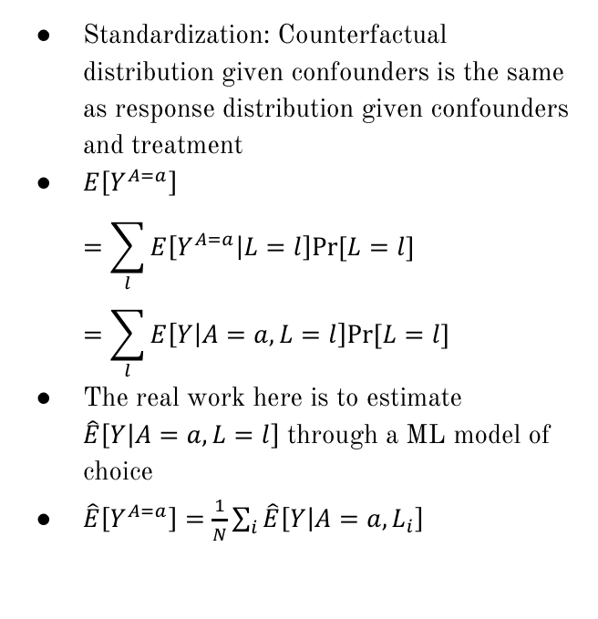
G-formula
Standardization: Counterfactual distribution given confounders is the same as response distribution given confounders and treatment
$E\left[Y^{A=a}\right]$ $=\sum_{l}{E\left[Y^{A=a} | L=l\right]Pr⁡[L=l]}=\sum_{l}{E\left[Y | A=a,L=l\right]Pr⁡[L=l]}$
The real work here is to estimate $\hat{E}\left[Y | A=a,L=l\right]$ through a ML model of choice
$\hat{E}\left[Y^{A=a}\right]=\frac{1}{N}\sum_{i}{\hat{E}\left[Y | A=a,L_{i}\right]}$

Slide 10
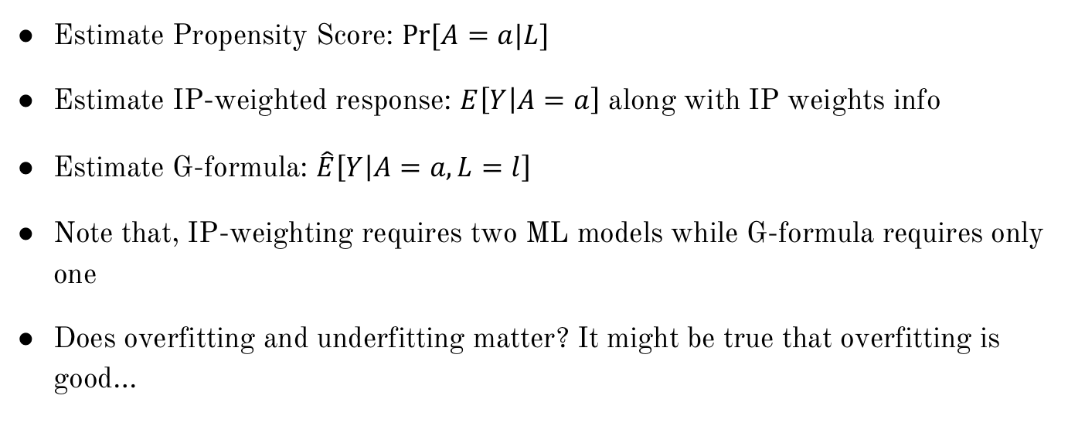
How Machine Learning is incorporated?
Estimate Propensity Score: $Pr⁡[A=a|L]$
Estimate IP-weighted response: $E\left[Y | A=a\right]$ along with IP weights info
Estimate G-formula: $\hat{E}\left[Y | A=a,L=l\right]$
Note that, IP-weighting requires two ML models while G-formula requires only one
Does overfitting and underfitting matter? It might be true that overfitting is good…

